Slide 1
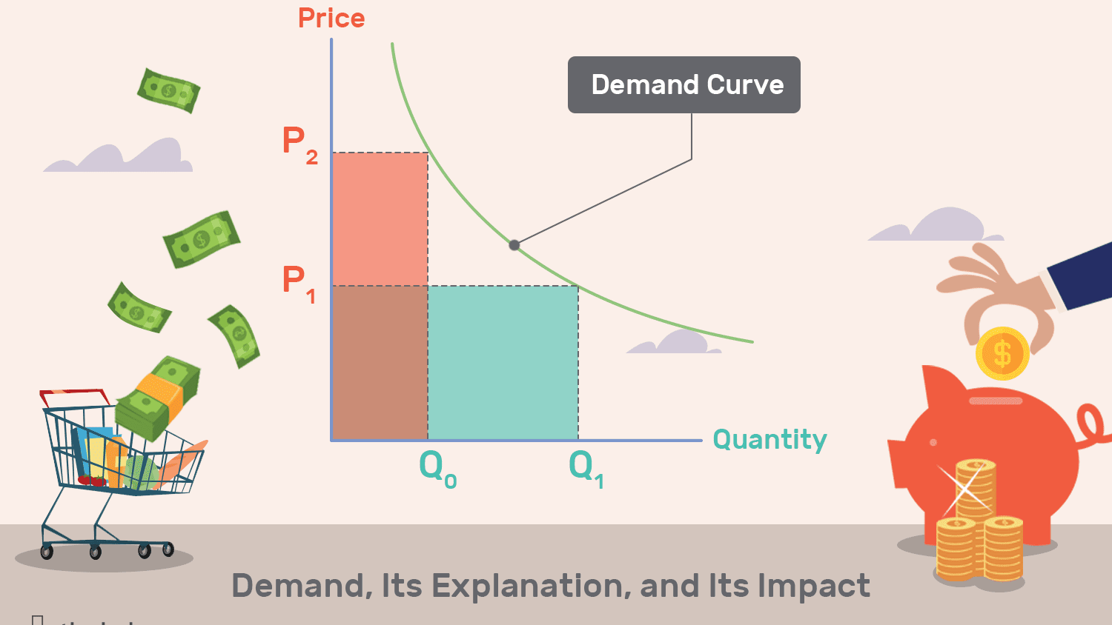

Dr. Sugyanta Priyadarshini
KSOH,KIIT

Slide 2
Concepts to be covered:
Relationship between Price and Demand
Individual Demand
Market Demand
Factors affecting Demand
Types of Goods
Law of Demand
Change in Demand vs Change in Quantity Demanded

Slide 3
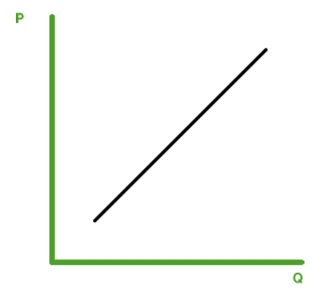
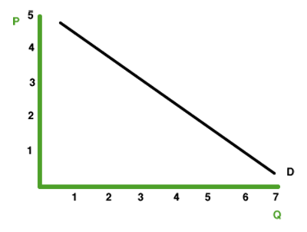
RELATIONSHIP BETWEEN PRICE AND DEMAND

Slide 4
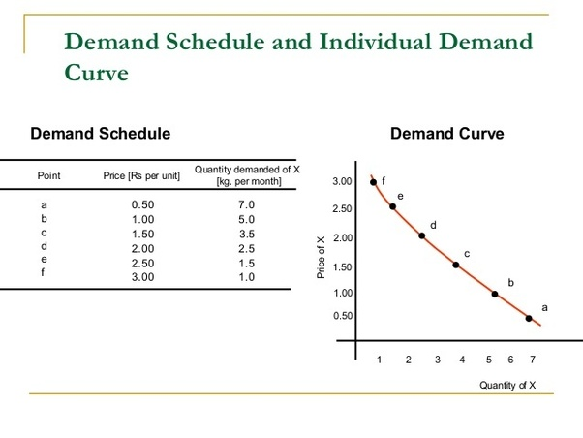
Individual Demand
Individual demand refers to the demand for a good or a service by an individual.
Individual demand comes from the interaction of an individual's desires with the quantities of goods and services that he or she is able to afford.

Slide 5
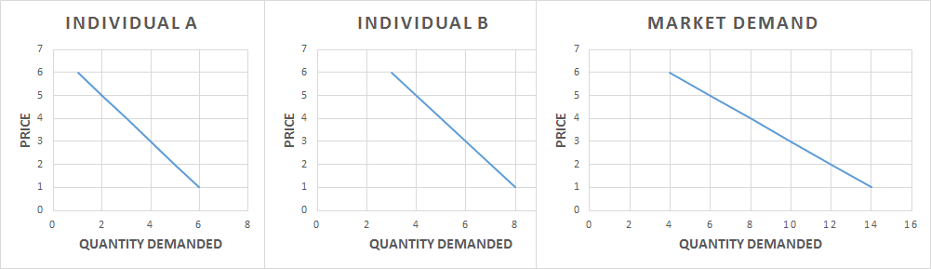
Market Demand
Market demand is the total quantity demanded across all consumers in a market for a given good.
To get the market demand, we simply add together the demands of the two households at each price. For example, when the price is $5, the market demand is 6 chocolate bars (5 demanded by household 2 and 1 demanded by household 1).

Slide 6

Market Demand curve is flatter than Individual Demand curve…

Slide 7
FACTORS AFFECTING DEMAND
Advertisement/Feedback
Taste and Habit
PRICE OF RELATED GOODS
Quality
Price
Income
Expectation of change in the price in future

Slide 8
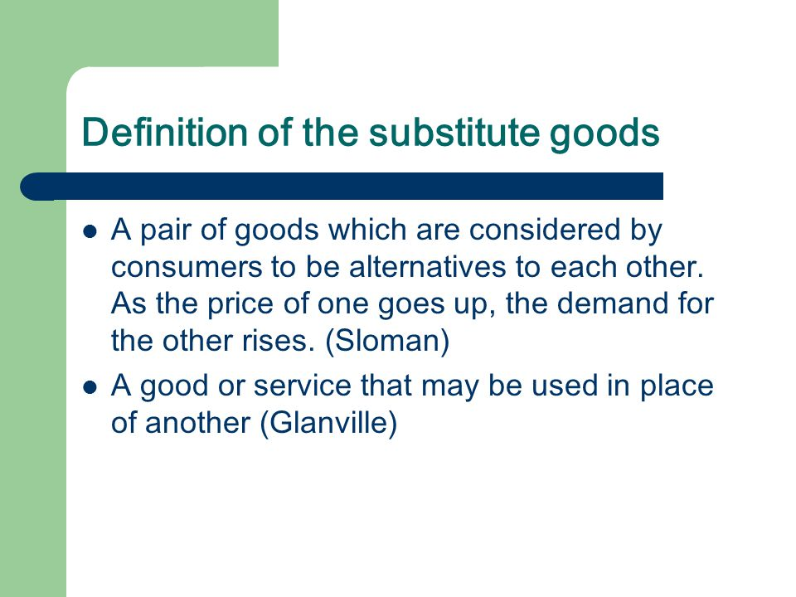
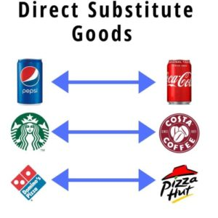
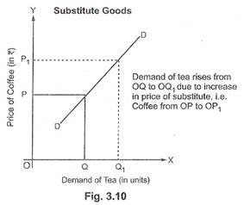

Slide 9
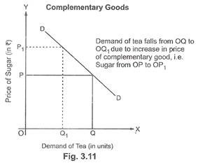
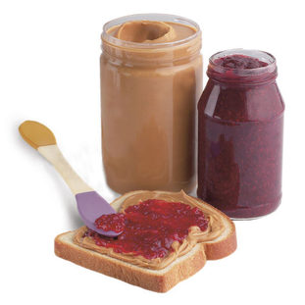
Definition of Complementary goods A Complementary good is a product or service that adds value to another. In other words, they are two goods that the consumer uses together. For example, cereal and milk. On occasion, the complementary good is absolutely necessary, as is the case with petrol and a car.

Slide 10
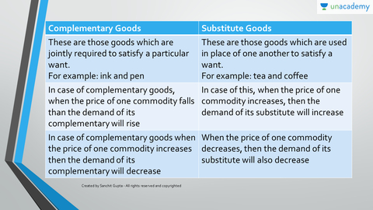

Slide 11

If price of Tea increases; what will happen to demand for coffee?

Slide 12
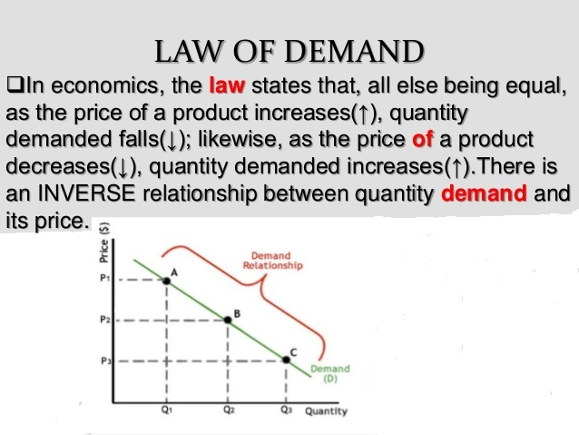
CETERIS PARIBUS: KEEPING ALL OTHER FACTORS AS CONSTANT

Slide 13
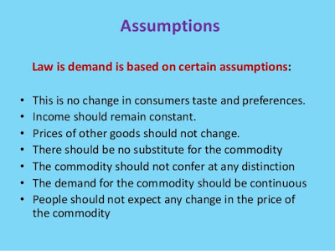
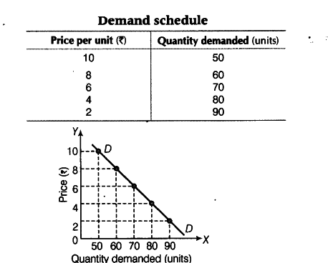

Slide 14
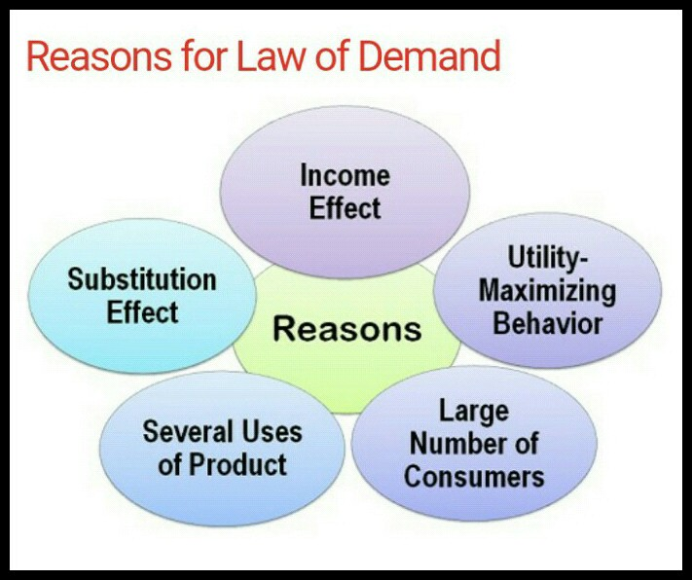

Slide 15
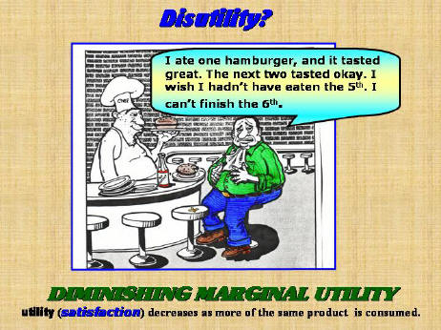
Law of Diminishing Marginal Utility The law of diminishing marginal utility explains that as a person consumes an item or a product, the satisfaction or utility that they derive from the product wanes as they consume more and more of that product. For example, an individual might buy a certain type of chocolate for a while. Soon, they may buy less and choose another type of chocolate or buy cookies instead because the satisfaction they were initially getting from the chocolate is diminishing.

Slide 16
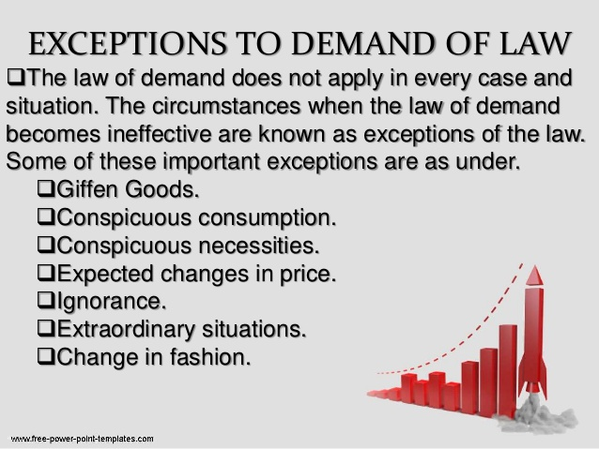

Slide 17
Types of Goods A normal good means an increase in income causes an increase in demand. Example: ordinary broadband, ordinary tv license, Ford Focus car. A luxury good means an increase in income causes a bigger percentage increase in demand. For example, HD TV’s would be a luxury good. When income rises, people spend a higher percentage of their income on the luxury good. An inferior good means an increase in income causes a fall in demand. An example of an inferior good is Tesco value bread. When your income rises you buy less Tesco value bread and more high quality, organic bread. Necessity good – something needed for basic human existence, e.g. food, water, housing, electricity. Comfort good – a good which isn’t a necessity, but gives enjoyment/utility, e.g. subscription to Netflix or take-away food. Complementary Goods. Goods which are used together, e.g. TV and DVD player. Substitute goods. Goods which are alternatives, e.g. Pepsi and Coca-Cola. Veblen / Snob good. A good where an increase in price encourages people to buy more of it. This is because they think more expensive goods are better. Example of Veblen / Snob good – some forms of art, designer clothes.

Slide 18
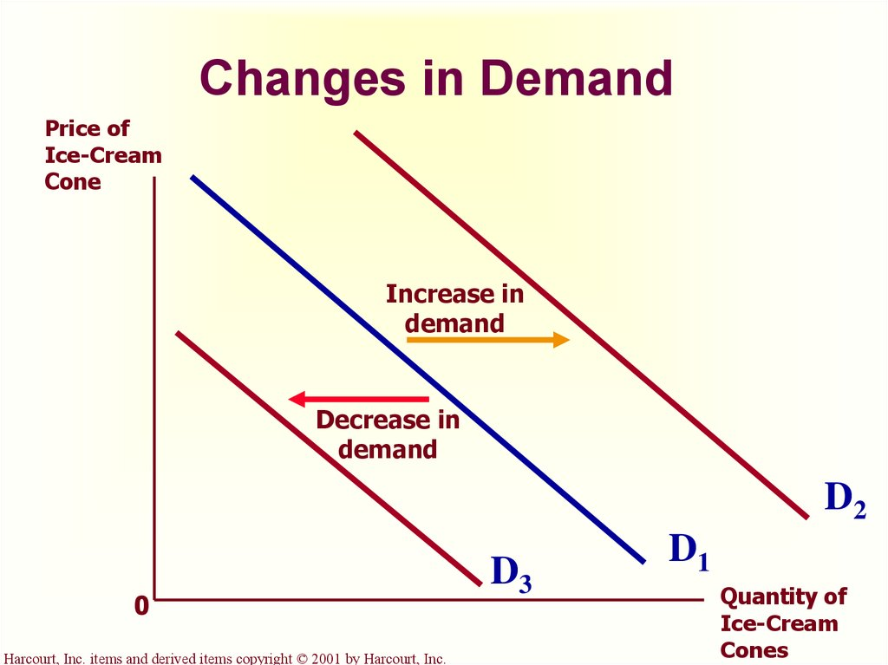
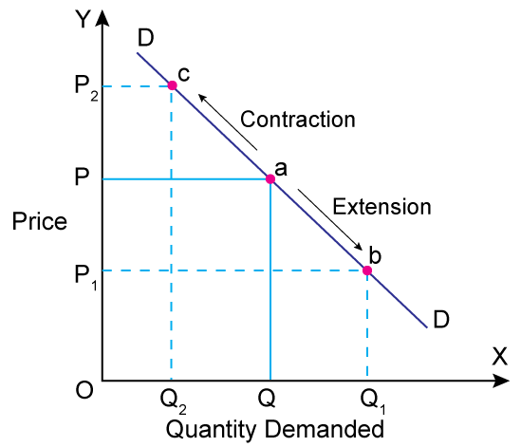
Change in Quantity Demanded

Slide 19
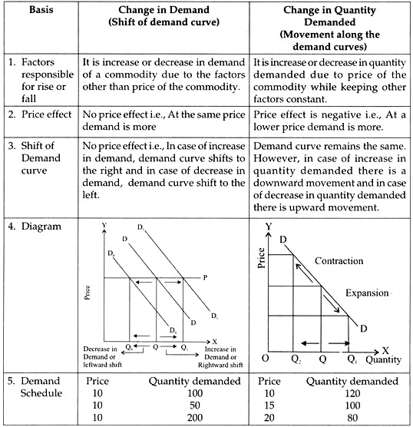

Slide 20

Thank you…

